Slide 1
CLIENT QUERY MANGEMENT SYSTEM
Admin,Support,Client.

Slide 2

Hello! I’m... SHOLINGAN
I have created a Client Query Management System for handling customer tickets.

Slide 3
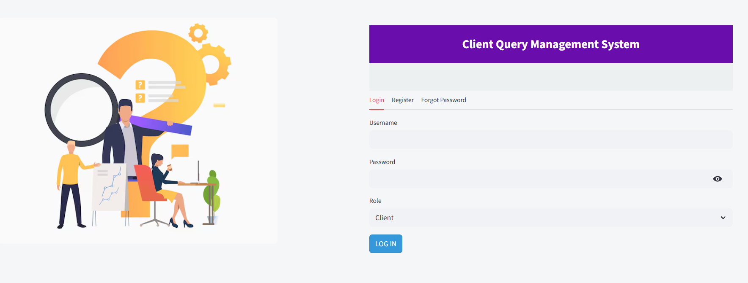
Home Page

Slide 4
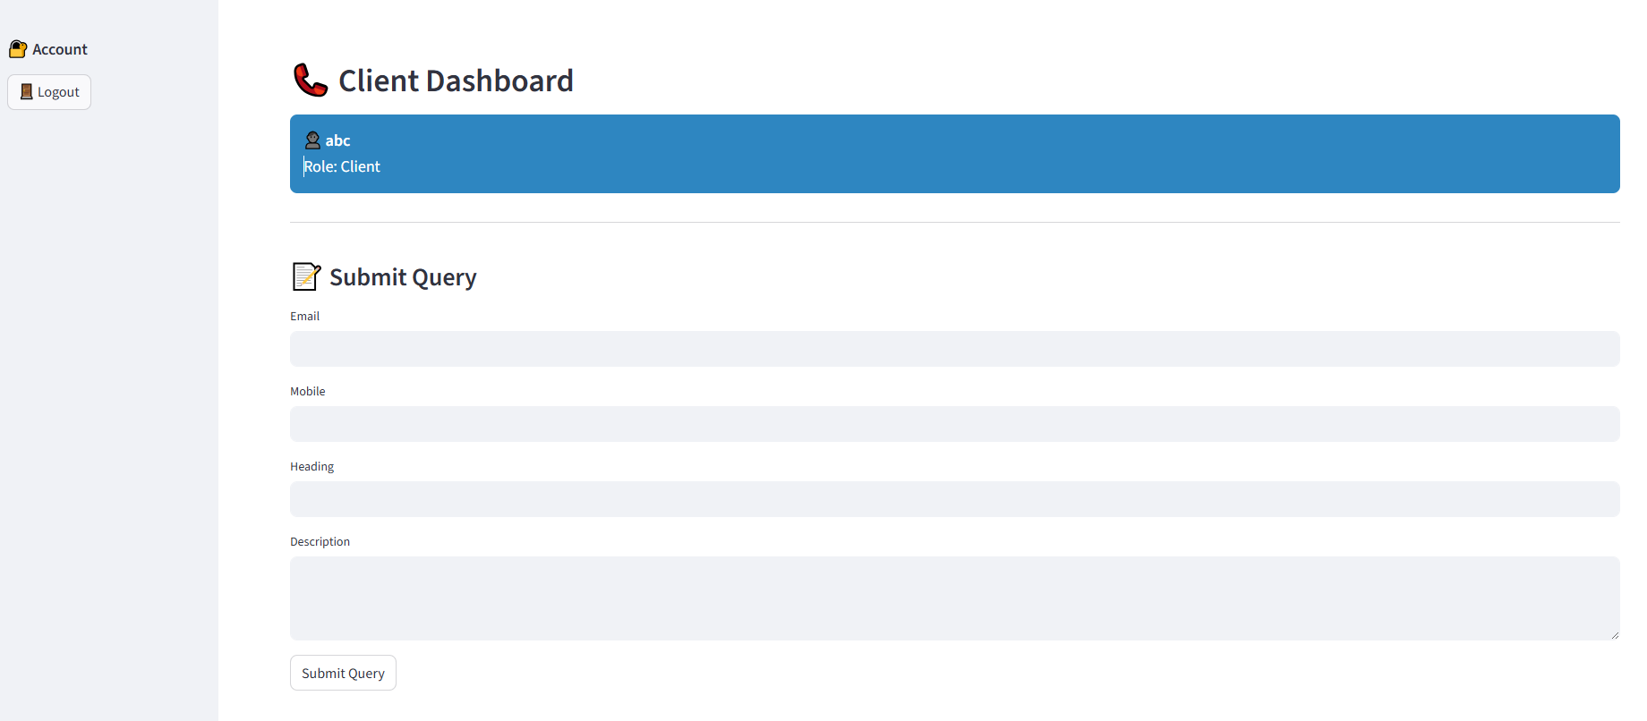

Slide 5
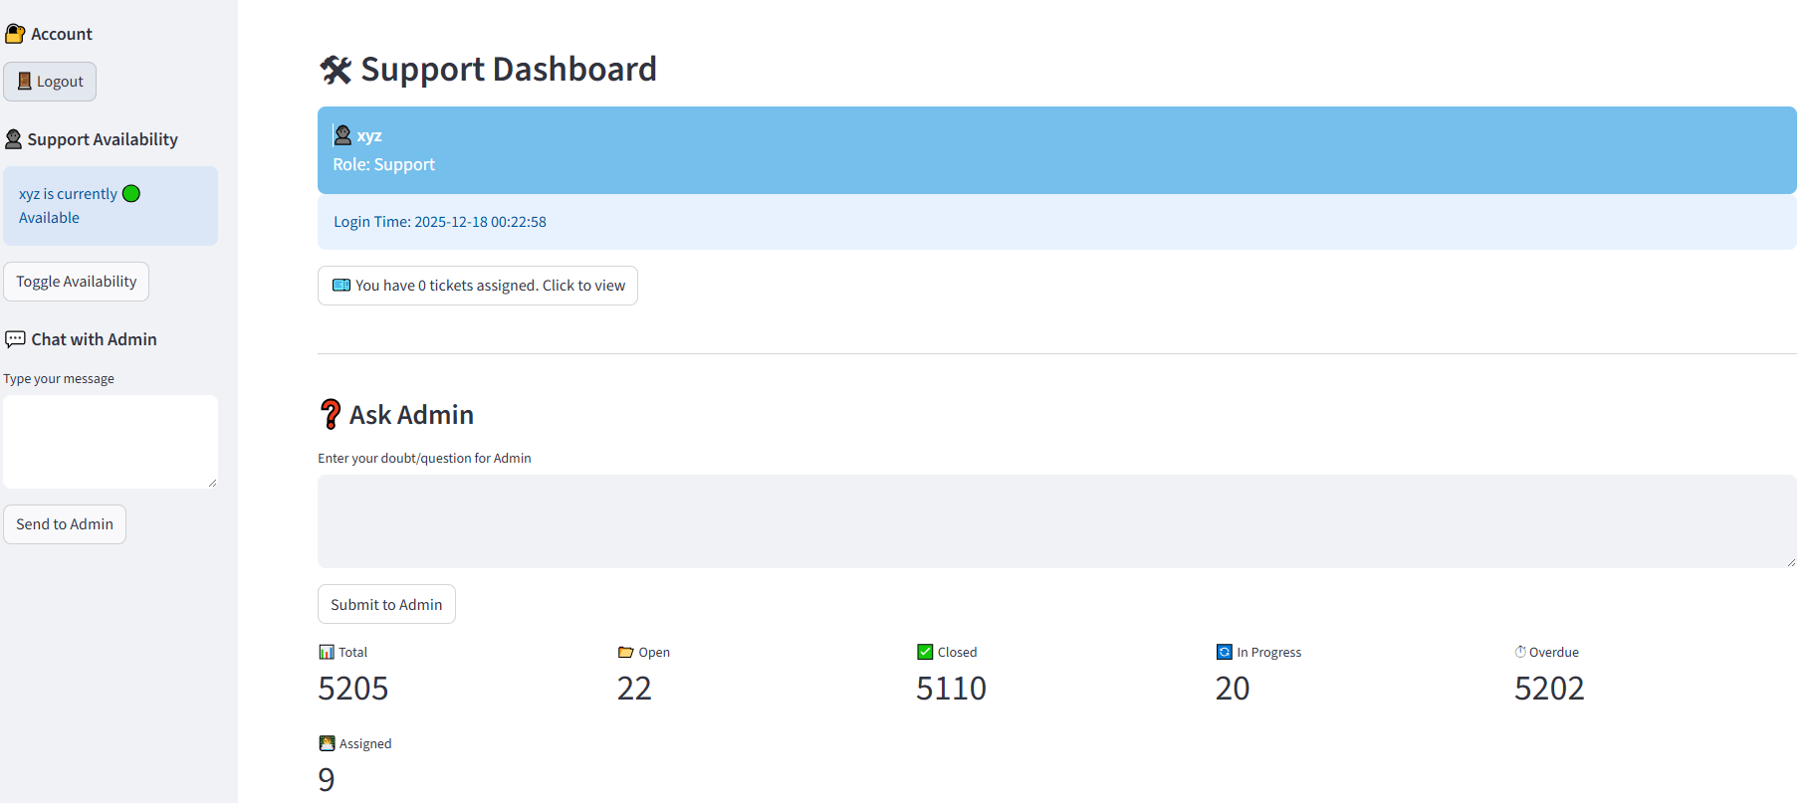
Support Availability, doubt clarification and Chat with admin

Slide 6
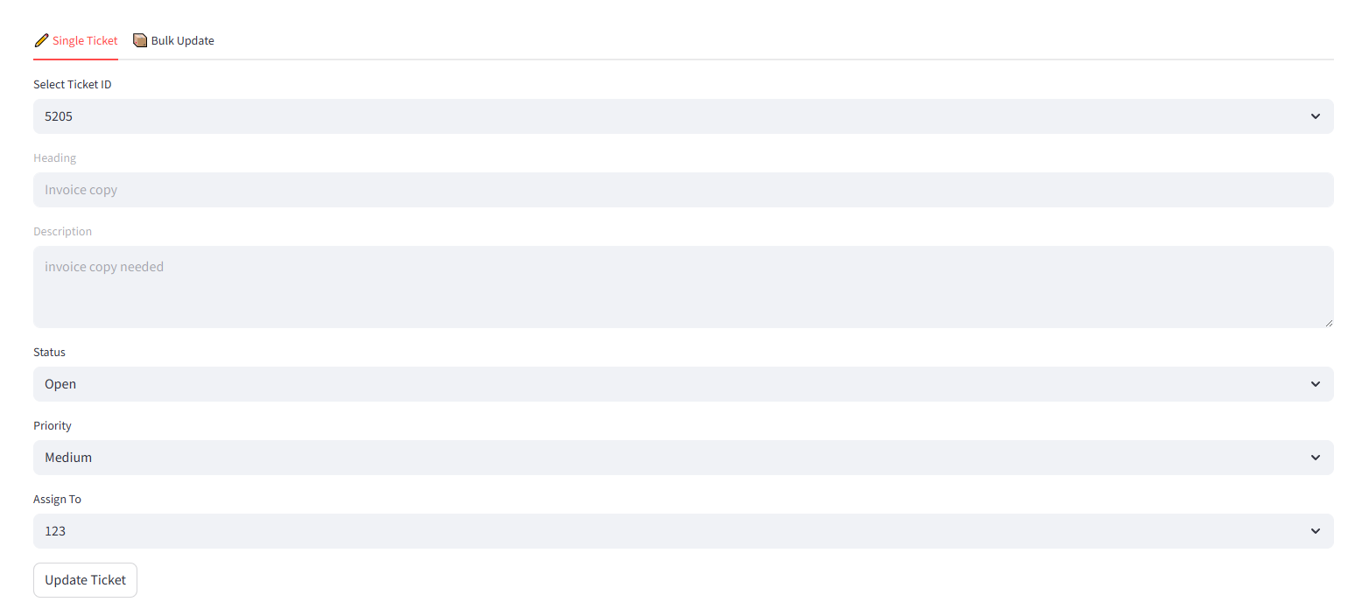
Ticket Update Single & Bulk

Slide 7
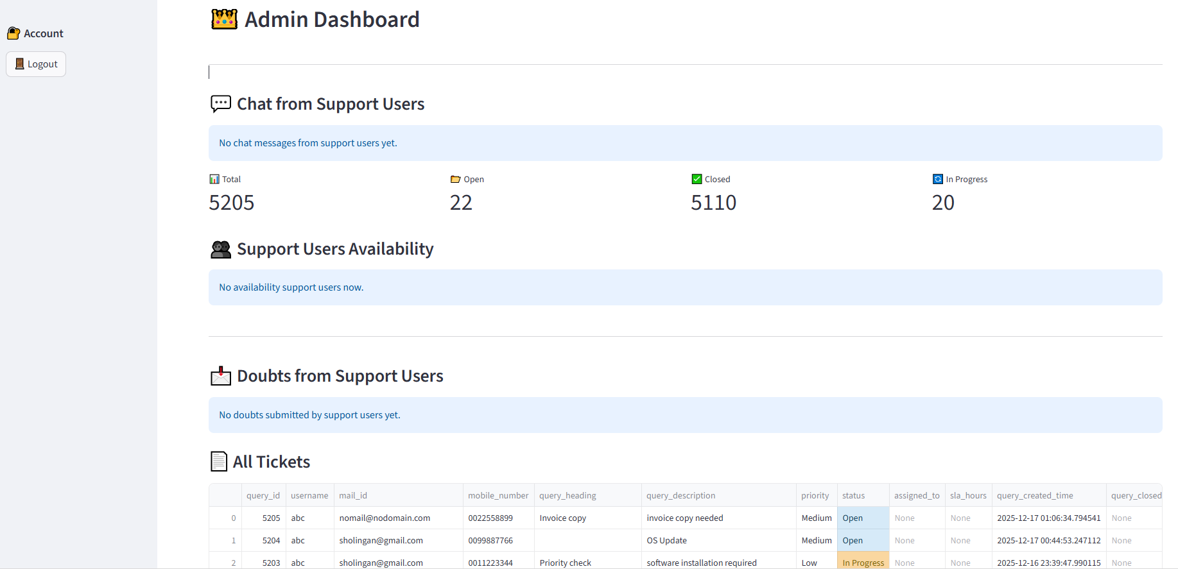
1.Support Users Chat
2.User Availability
3.Doubt from Support users
4.All tickets
5.Periority Status

Slide 8
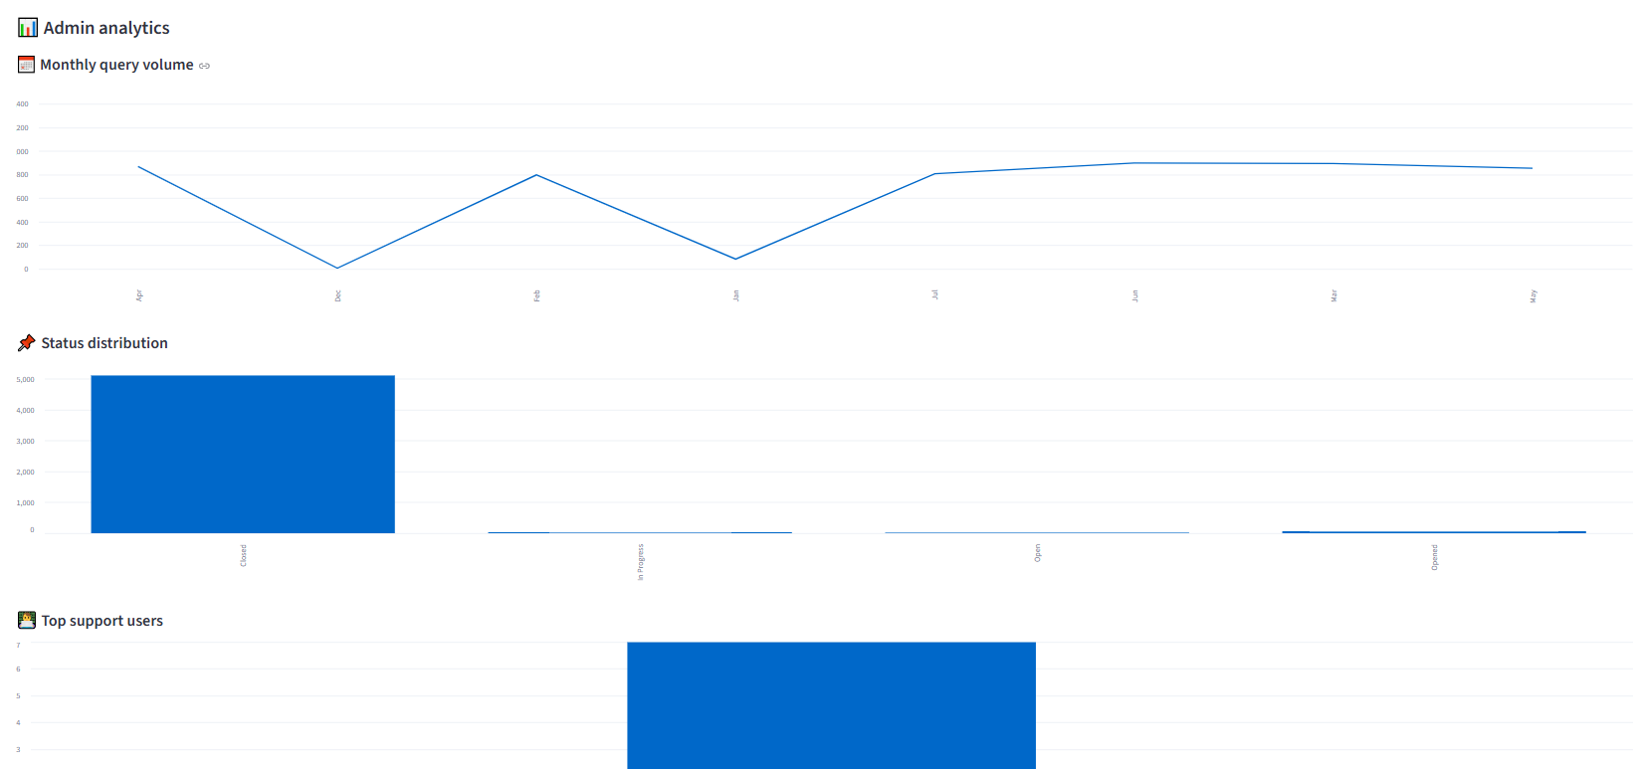
Admin Analytics Monthly/Yearly and Top support users

Slide 9
Used Technology
1.STREAMLIT 2.PANDAS
3.VSCODE 4.PSYCOPG2
5.HASHLIB 6.DOTENV
7.NUMPY 8.Barchart

Slide 10

Thank you!
Do you have any questions?

